Slide 1
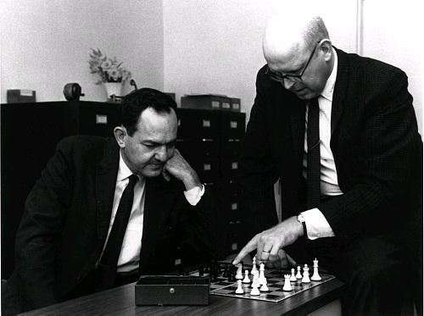

Slide 2
HEAD
TAIL
1
2
3

Slide 3
HEAD
TAIL
1
2
3

Slide 4
HEAD
TAIL
0
1
2
3
HEAD
TAIL
1
1
2
3
HEAD
TAIL
2
1
2
3

Slide 5
HEAD
TAIL
0
1
1
2
3
5
HEAD
TAIL
0
1
1
2
3
5
HEAD
TAIL
0
1
2
1
5
2
3

Slide 6
HEAD
TAIL
0
1
2
1
2
3
HEAD
TAIL
0
1
2
1
2
3
HEAD
TAIL
0
1
1
3
2

